Slide 1


Assiut University Faculty of Computers & Information Computer Science Department
Intelligent Systems
DR.SARA SALAH MOHAMED

Slide 2
Grading
Assessment | Grade %
Final Exam | 50%
Class Work | 6%
Mid-Term Exam | 15%
Project | 24%

Slide 3
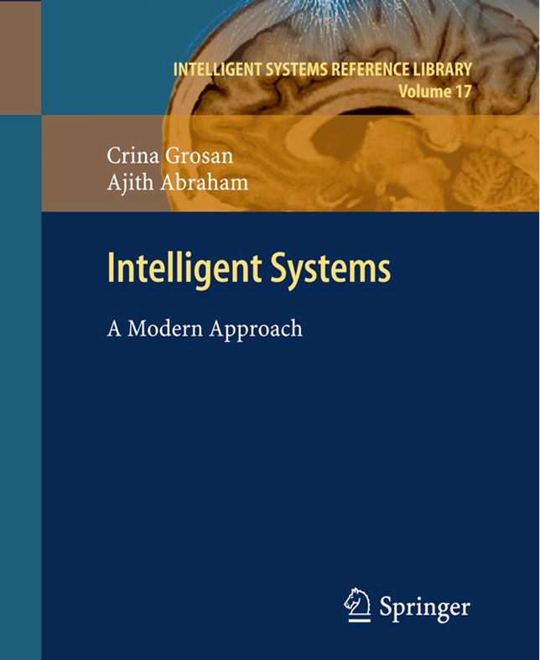
Text Book

Slide 4
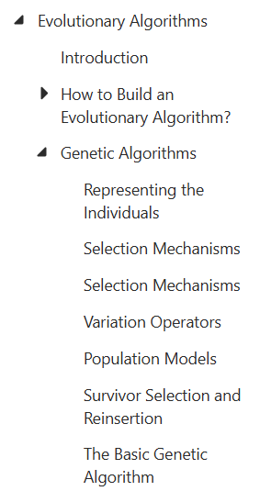
Content

Slide 5
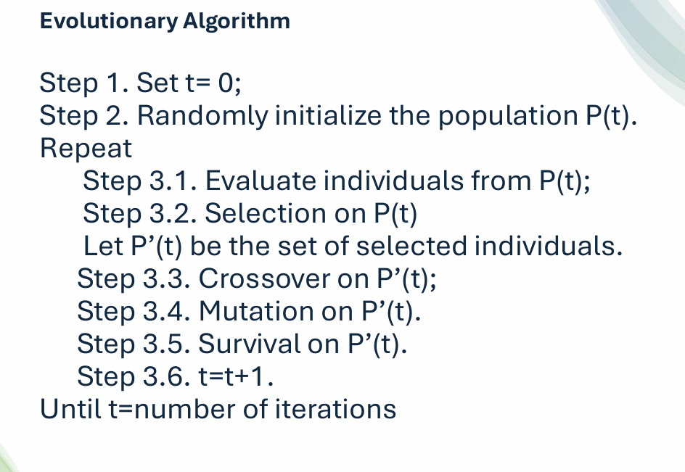

Slide 6
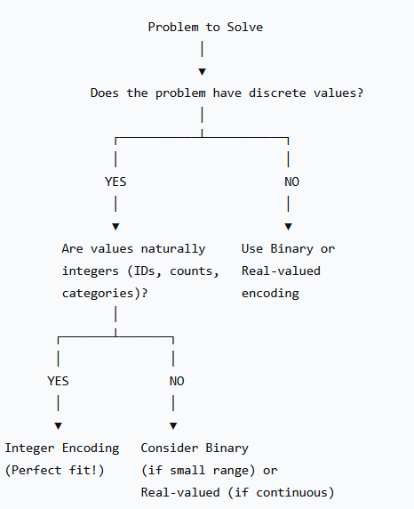
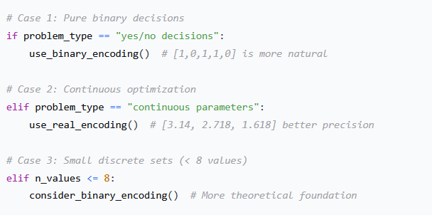
When to Use Integer Encoding?
When NOT to Use Integer Encoding?

Slide 7

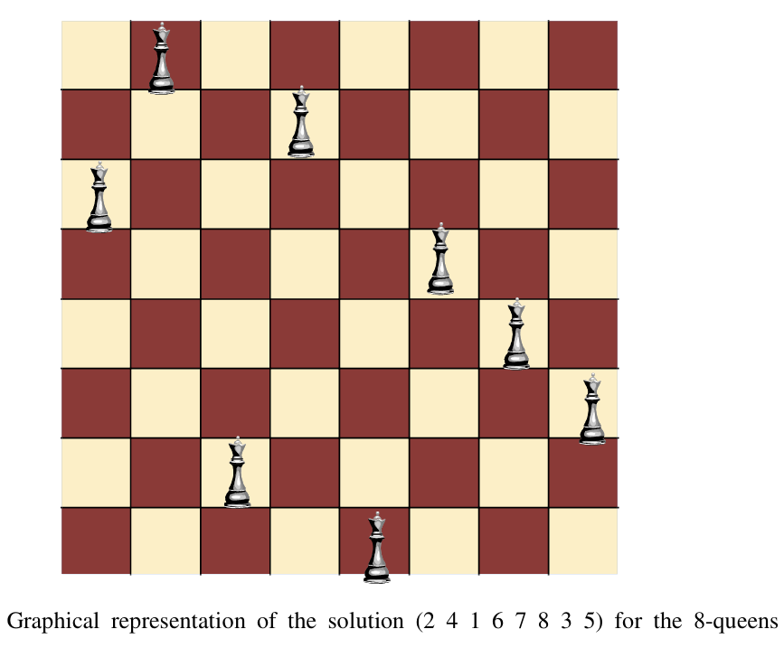
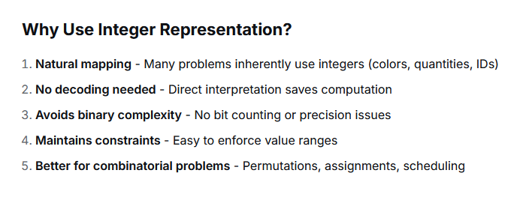
2-Integer Representation
Integer representation uses whole numbers (integers) as genes in a chromosome. Each position can take values from a specified set or range of integers, making it ideal for problems with discrete, countable options.

Slide 8
Types of Integer Representation
1. Value Encoding (Simple Integers)
Each gene can be any integer within a range
Problem: Assign quantities to 5 products (0-100 units each)
Chromosome: [45, 67, 12, 89, 33]
Meaning: Product1=45 units, Product2=67 units, etc.
2. Permutation Encoding (Order-Based)
Each integer appears exactly once, represents a sequence or order.
Problem: Traveling Salesman Problem (visit 8 cities)
Chromosome: [3, 1, 4, 2, 7, 5, 8, 6]
Meaning: Visit city3 → city1 → city4 → city2 → city7 → city5 → city8 → city6
3. Multi-Parameter Encoding
Different genes represent different types of parameters
Problem: Design a car (color, engine, wheels, transmission)
Domains: Color(1-6), Engine(1-4), Wheels(1-3), Transmission(1-2)
Chromosome: [3, 2, 1, 2]
Meaning: Blue car, V6 engine, Alloy wheels, Automatic

Slide 9
Crossover or Recombination for Integer Representation
Crossover for Value Encoding
1-Single-Point Crossover: cut both parents at the same point and swap tails as we learn in binary representation .
parent1: [45, 67, 12 | 89, 33, 21, 54, 78]
Parent2: [23, 56, 91 | 34, 62, 85, 47, 19]
↑
Cut point
Child1: [45, 67, 12 | 34, 62, 85, 47, 19]
Child2: [23, 56, 91 | 89, 33, 21, 54, 78]
2 Two-Point Crossover
Selects a segment between two points and swaps it between parents.
Parent1: [45, 67 | 12, 89, 33 | 21, 54, 78]
Parent2: [23, 56 | 91, 34, 62 | 85, 47, 19]
↑ ↑
Point1 Point2
Child1: [45, 67 | 91, 34, 62 | 21, 54, 78]
Child2: [23, 56 | 12, 89, 33 | 85, 47, 19]

Slide 10
3. Uniform Crossover
Each gene is independently chosen from either parent with equal probability.
Parent1: [45, 67, 12, 89, 33, 21, 54, 78]
Parent2: [23, 56, 91, 34, 62, 85, 47, 19]
Mask: [ 1, 0, 1, 0, 1, 0, 1, 0]
Child1: [45, 56, 12, 34, 33, 85, 54, 19] (from P1 where mask=1, else P2)
Child2: [23, 67, 91, 89, 62, 21, 47, 78] (opposite of Child1)
4. Arithmetic Crossover
Creates children as weighted averages of parents. Three types(simple, single arithmetic and whole arithmetic)
whole arithmetic
p1 = [10, 20, 30, 40, 50]
p2 = [90, 80, 70, 60, 50]
Alpha = 0.3 (Child1 70% P2, 30% P1)
Position 0: Child1 = 0.3×10 + 0.7×90 = 3 + 63 = 66
Child2 = 0.7×10 + 0.3×90 = 7 + 27 = 34
Position 1: Child1 = 0.3×20 + 0.7×80 = 6 + 56 = 62
Child2 = 0.7×20 + 0.3×80 = 14 + 24 = 38
... and so on

Slide 11
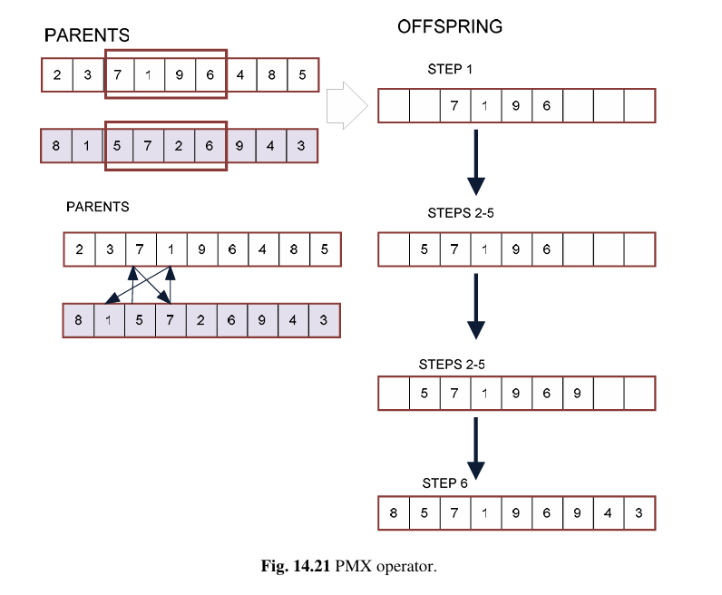
Crossover for Permutation Encoding
In permutation encoding, each integer appears exactly once. Standard crossover would create invalid solutions with duplicates.
1. Partially mapped crossover Partially mapped crossover (PMX): has been proposed in [19] as a recombination operator for the TSP. There exist now several variants of it.

Slide 12
Step 1: Select segment
Parent1: [3, 1, | 4, 2, 7 |, 5, 8, 6]
Parent2: [2, 4, | 1, 3, 6 |, 8, 5, 7]
↑ ↑
point1 point2
Step 2: Copy segment from Parent1 to child
Child: [-, -, | 4, 2, 7 |, -, -, -]
Step 3: Create mapping from segment
Compare positions in the segment:
Position 2: P1=4, P2=1 → 4 ↔ 1
Position 3: P1=2, P2=3 → 2 ↔ 3
Position 4: P1=7, P2=6 → 7 ↔ 6
Mapping: {4:1, 2:3, 7:6}
Step 4: Fill remaining positions from Parent2
Position 0: P2[0]=2 → 2 maps to 3 → Child[0]=3
Position 1: P2[1]=4 → 4 maps to 1 → Child[1]=1
Position 5: P2[5]=8 → 8 not in map → Child[5]=8
Position 6: P2[6]=5 → 5 not in map → Child[6]=5
Position 7: P2[7]=7 → 7 maps to 6 → Child[7]=6
Final Child: [3, 1, 4, 2, 7, 8, 5, 6]
Example PMX:

Slide 13
Selection
Selection is the process of choosing individuals from the current population to serve as parents for the next generation. It's the driving force that pushes the population toward better solutions.
The Role of Selection
Population → [SELECTION] → Mating Pool → [Crossover/Mutation] → New Population
↑ │
└────────────────── REPLACEMENT ──────────────────────────────┘
Key Properties of Selection Methods
Selection Pressure: How strongly better individuals are favored
Population Diversity: How well less-fit individuals are preserved
Convergence Speed: How quickly the population homogenizes
Computational Complexity: Time required to perform selection

Slide 14
Classification of Selection Methods
SELECTION METHODS
│
┌──────────────────┼────────────────── ─── ┐
│ │ │
FITNESS- RANK-BASED TOURNAMENT
PROPORTIONATE │ │
│ ┌────┴────┐ ┌────┴────┐
┌────┴────┐ Stochastic Deterministic Binary Tournament
│Roulette │ Universal (Elitism) Size k
│Wheel │ Sampling
│ │ (SUS)
└─────────┘

Slide 15
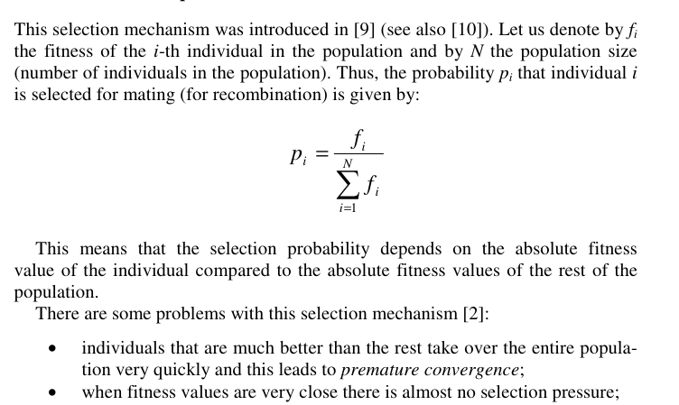
1 Roulette Wheel Selection
Also known as Fitness-Proportionate Selection. Individuals are selected with probability proportional to their fitness.

Slide 16
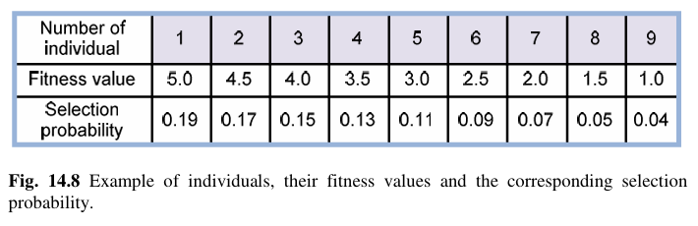
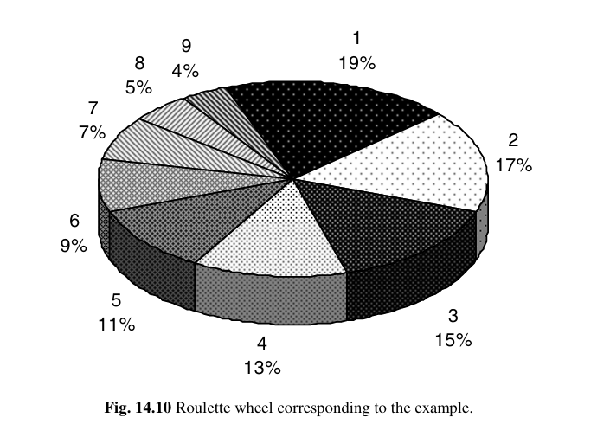

Slide 17
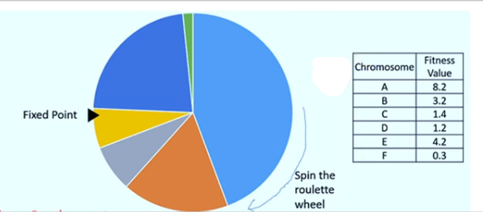

Slide 18
جزاكم الله خيرا
وصل اللهم على سيدنا محمد وعلى اله وصحبه وسلم

